Slide 1

Understanding Energy Consumption and Demand Forecasting in the USA

Slide 2

Team Introduction
Parth
Shivangi
Kunal
Aishwarya
Prasanna Kumar

Slide 3
Brief Overview
Importance of Energy Consumption Management
Rising Concerns Over Population Growth and Its Impact
Focus on USA's Energy Landscape

Slide 4
Data Sources
Comprehensive Data Ecosystem: Our project draws from a diverse array of data sources, ensuring a holistic understanding of energy consumption (Electricity) dynamics.
Primary Source: Data has been downloaded from the Open Government of USA, providing access to a rich dataset encompassing various facets of energy consumption.
Quality Assurance: Rigorous validation processes are in place to maintain the integrity and reliability of the acquired data.

Slide 5
Analytical Techniques
Predictive Modeling: Our analytical approach revolves around advanced predictive modeling, leveraging the power of Python for robust and accurate forecasts of electricity demand.
Segmentation Strategies: Employing Python-based analytics to conduct customer segmentation, enabling targeted marketing approaches and personalized energy solutions.
Insights Visualization: Data analysis isn't just numbers; it comes to life with insightful visualizations. Using Python's data visualization libraries, we generate dynamic charts that offer a clear understanding of consumption patterns and trends.

Slide 6

Project Goals
Understand Current Energy Consumption Patterns in the USA
Develop Accurate Forecasting Models for Future Demand
Analyze the Impact of Population Growth on Energy Consumption
Provide Recommendations for Sustainable Energy Management Strategies

Slide 7

Why Predicting Future Demand Matters
Optimized Resource Allocation:
Ensures efficient distribution of energy resources.
Cost Savings:
Helps utilities plan investments and avoid unnecessary expenses.
Grid Stability:
Ensures stable operations of the electricity grid.
Environmental Sustainability:
Facilitates the integration of renewable energy sources.
Enhanced Policy Planning:
Guides policymakers in crafting effective energy policies

Slide 8
Key Energy Sources in the USA
Natural Gas:
Abundant and versatile, used in both power generation and heating.
Solar:
Harnesses sunlight to generate electricity through photovoltaic cells or concentrated solar power systems.
Uranium (Nuclear):
Provides a stable base load of electricity with minimal greenhouse gas emissions.
Wind:
Utilizes wind turbines to convert kinetic energy into electricity, offering a clean and renewable energy source.
Biomass / Geothermal:
Biomass utilizes organic materials, while geothermal harnesses heat from the Earth's core, contributing to sustainable energy production.
Hydro / Wave / Tidal:
Hydroelectric power from dams, wave, and tidal energy offer renewable and predictable sources.

Slide 9
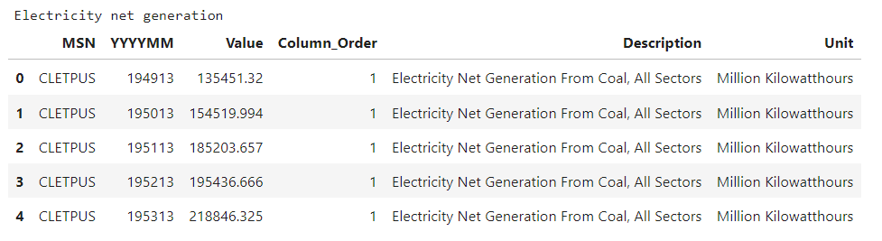
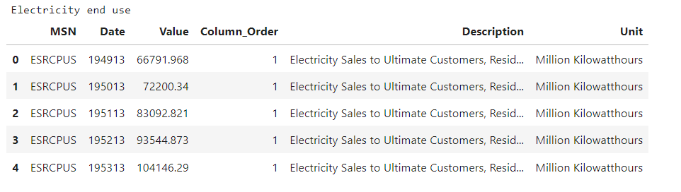
Data Samples
Values in Million Kilowatthours

Slide 10

Data Cleaning
Remove “Not Available” from Value Column
Change Date column name & datatype
Missing Values (Forward Fill)
Removing unnecessary columns

Slide 11
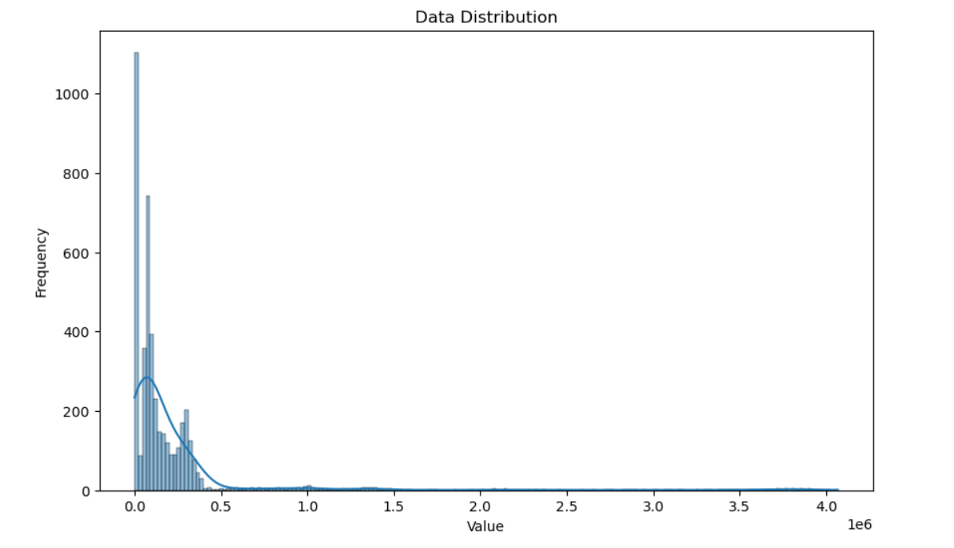
Data distribution

Slide 12
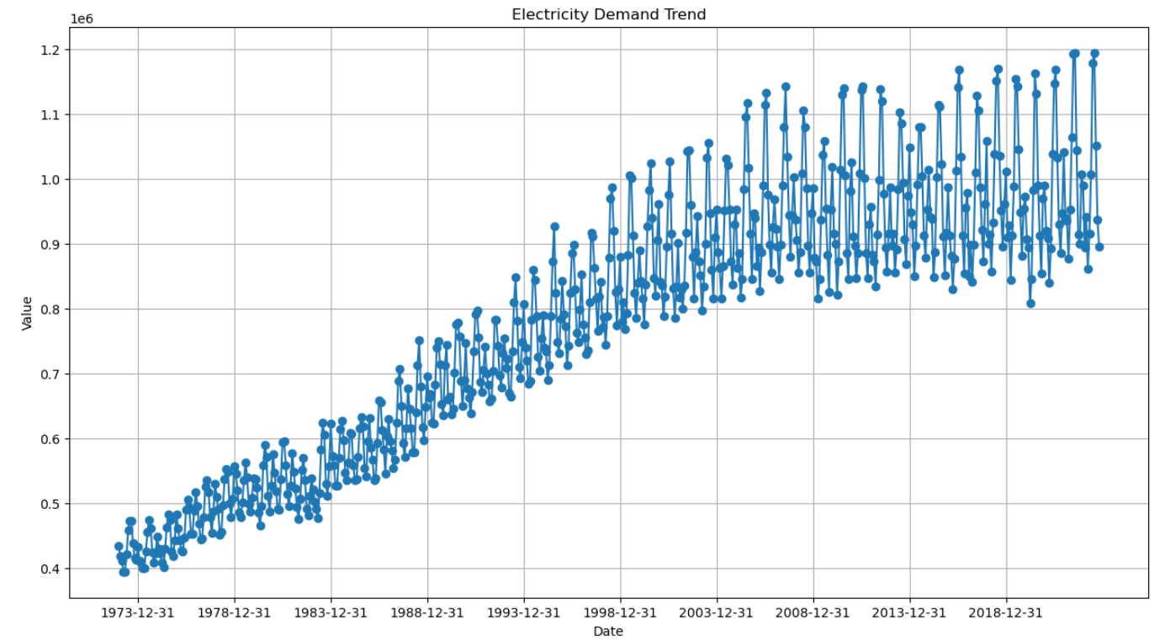
Electricity demand trends

Slide 13
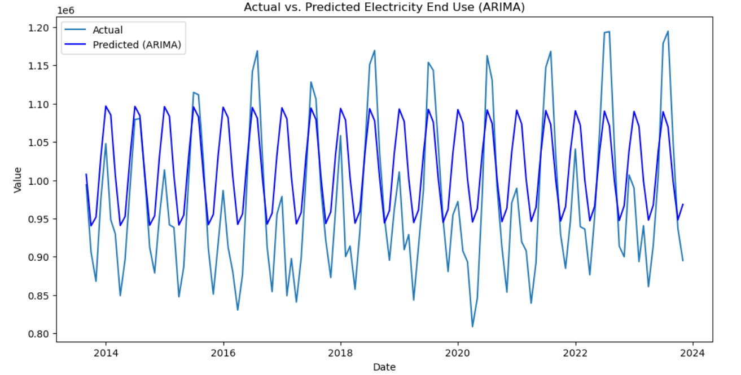
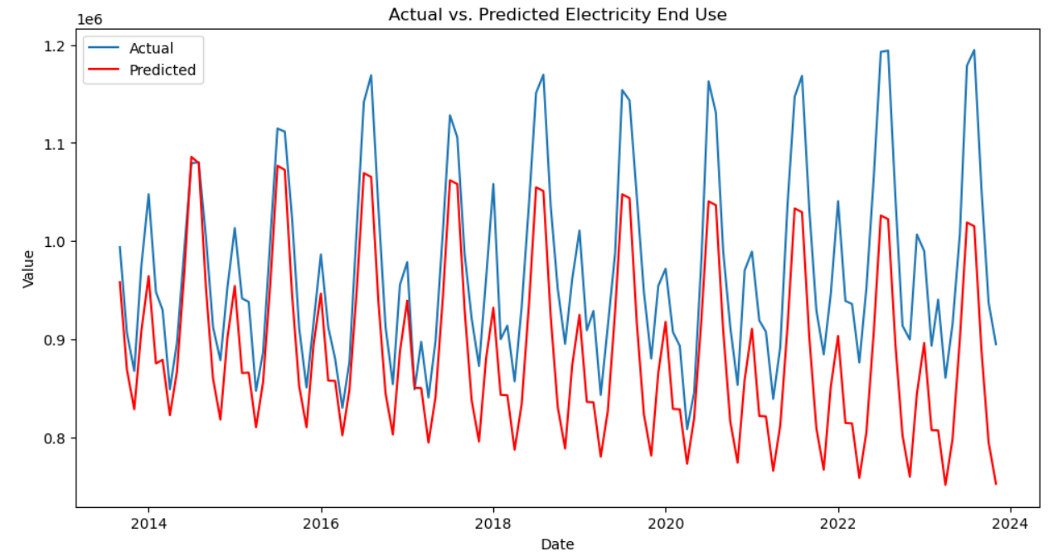
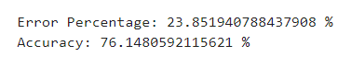
ARIMA
SARIMA

Slide 14
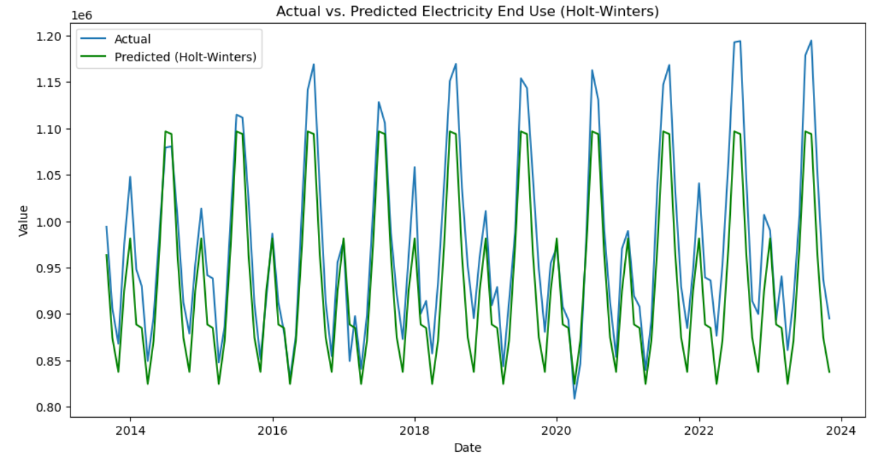
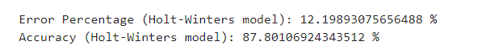
Holt winters exponential smoothing

Slide 15
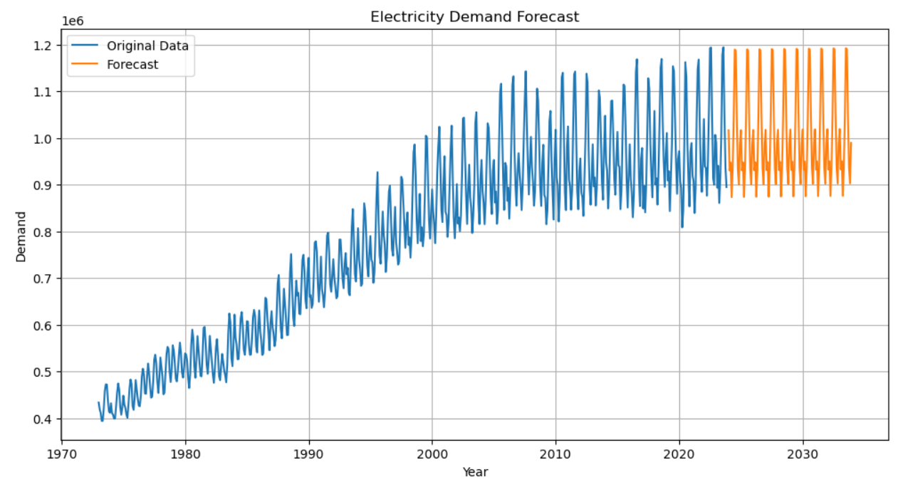
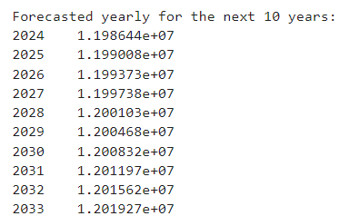
Electricity Demand Forecast

Slide 16
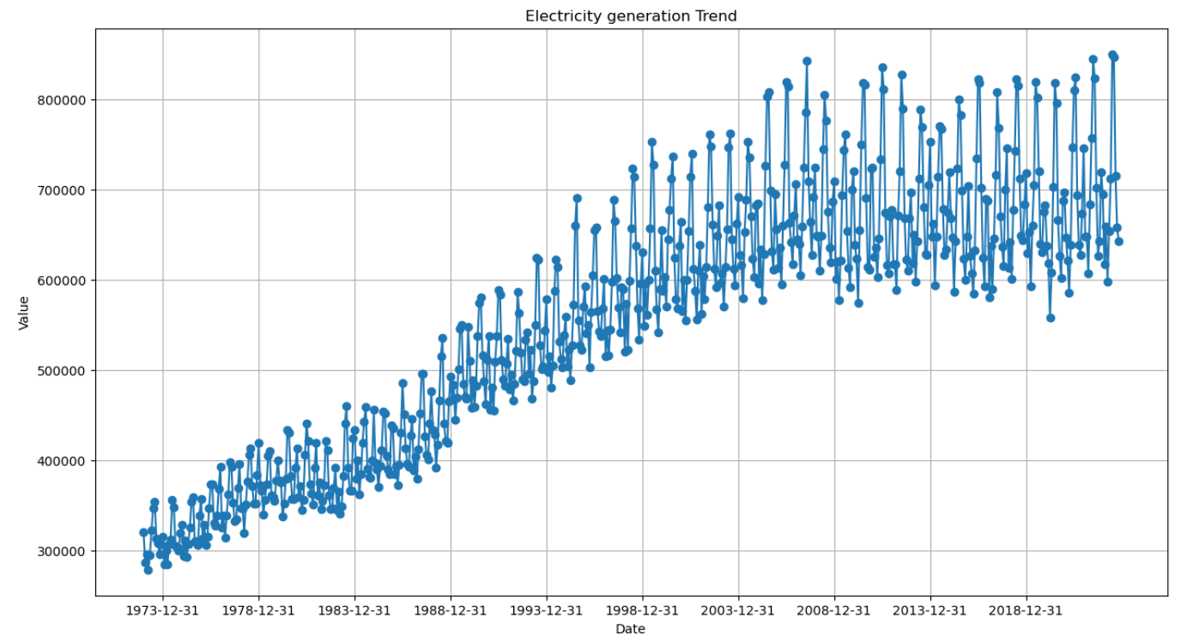
Electricity generation trends

Slide 17
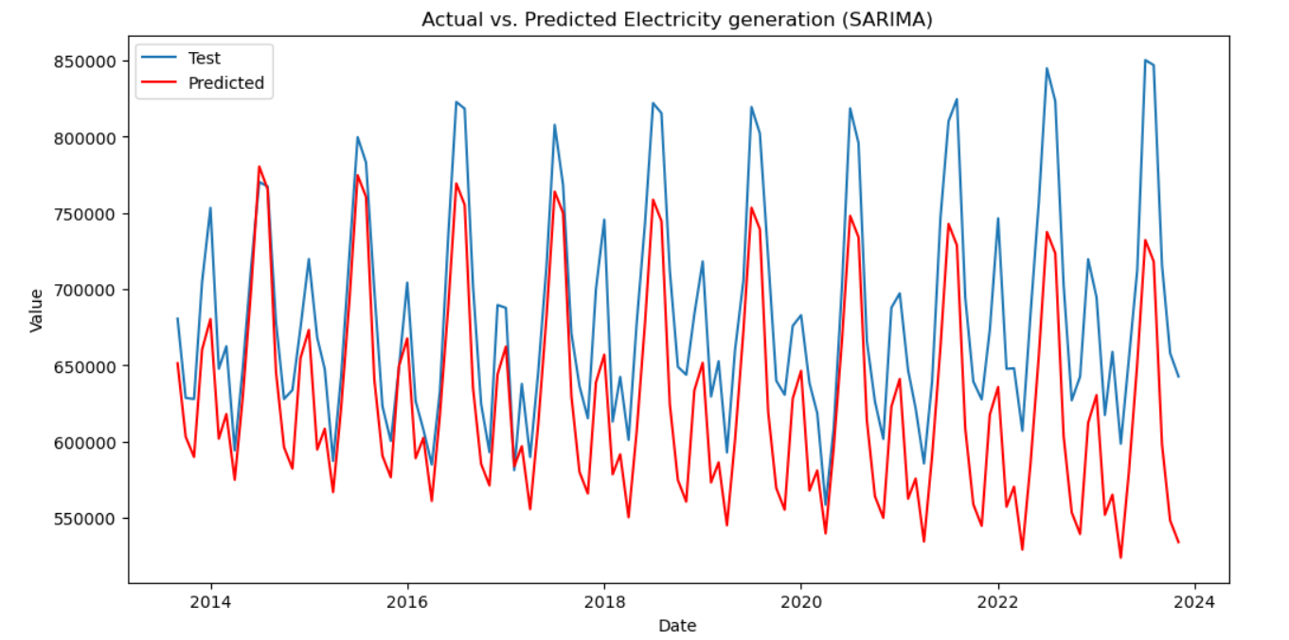
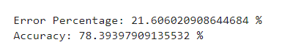
Electricity generation (SARIMA)

Slide 18
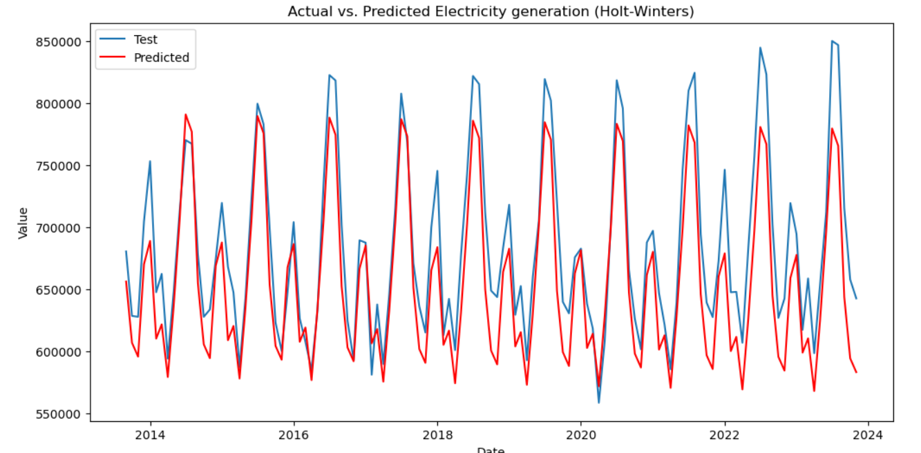
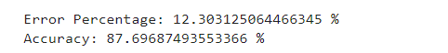
Electricity generation (Holt-Winters)

Slide 19
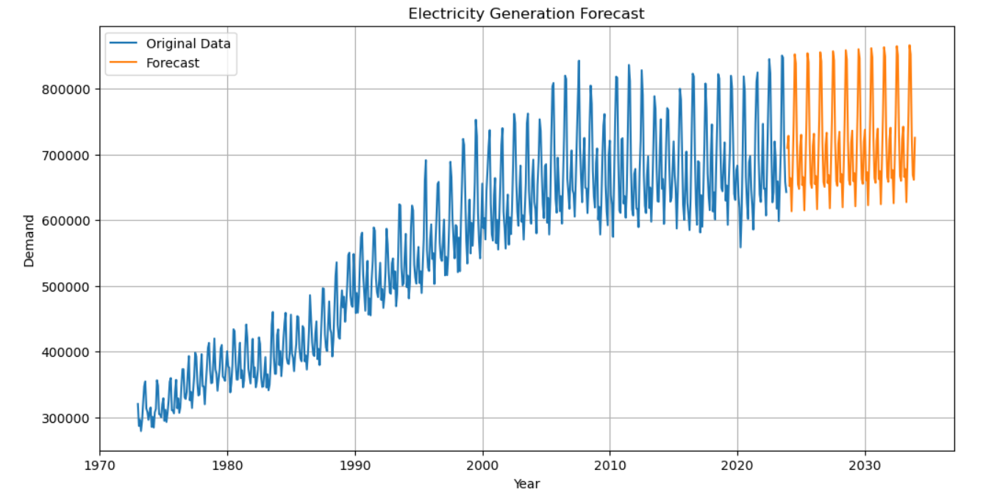
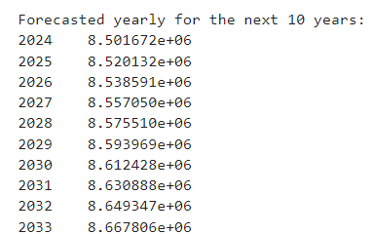
Electricity Generation Forecast

Slide 20
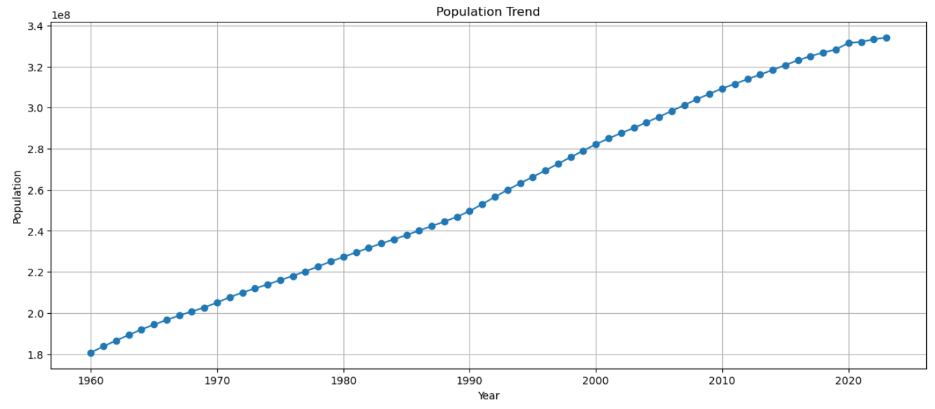
Population

Slide 21
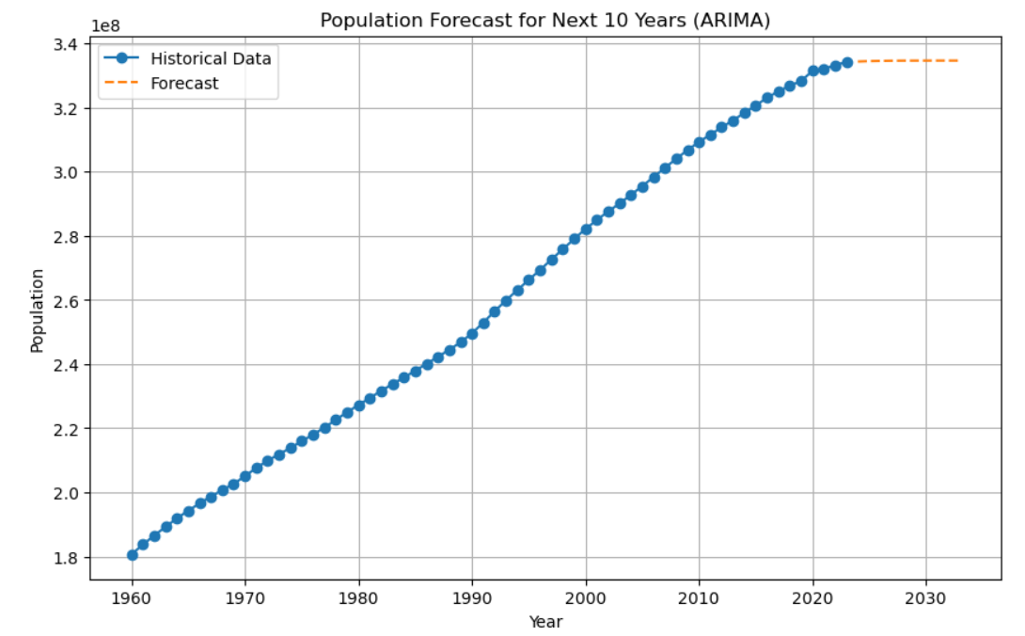
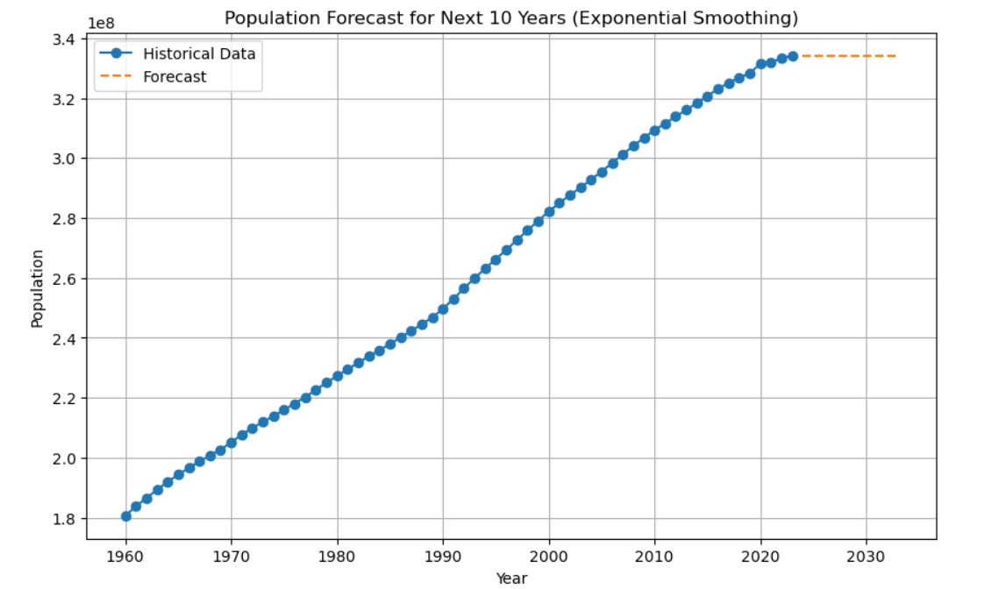
ARIMA
Exponential Smoothing

Slide 22
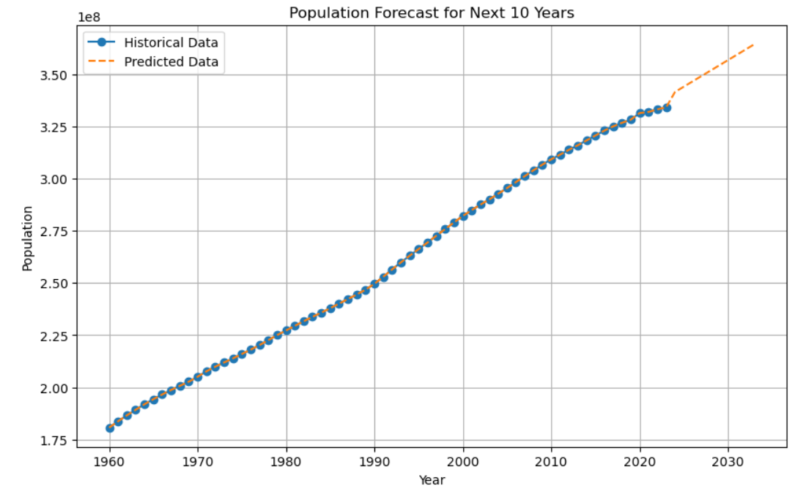
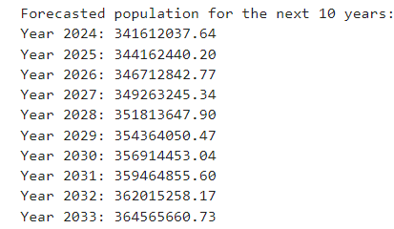
Linear Regression

Slide 23
Comparison for the year 2030
Electricity Generation Forecast
Electricity Demand Forecast
Percentage increase relative to the year 2023 = 8.59%
Percentage increase relative to the year 2023 = 3.23%
Population
Percentage increase relative to the year 2023 = 6.79%

Slide 24

Recommendations:
Investment in Infrastructure: There is a need to invest in upgrading and expanding electricity generation and transmission infrastructure to ensure reliability and meet the growing demand.
Promote Energy Efficiency: Encourage energy efficiency measures at both the consumer and industrial levels to reduce overall electricity demand and mitigate the need for additional generation capacity.
Diversify Energy Sources: Explore and invest in a diverse range of energy sources, including renewable energy sources such as solar, wind, and hydroelectric power, to reduce reliance on fossil fuels and enhance energy security.
Policy Support: Develop and implement supportive policies and regulations that encourage energy conservation, promote renewable energy deployment, and incentivize investment in energy infrastructure.

Slide 25
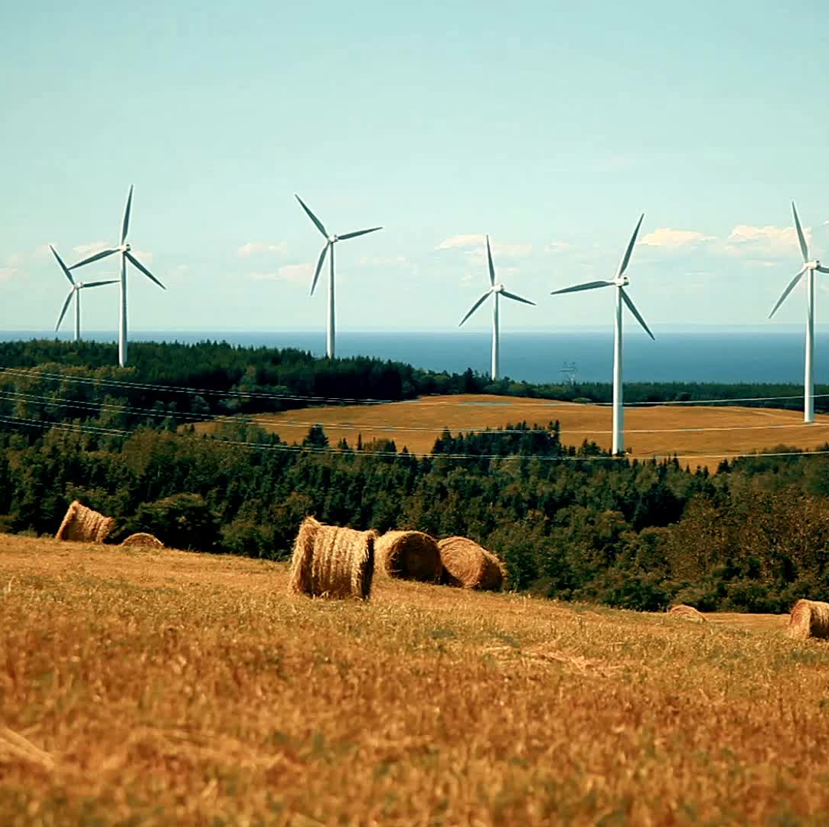
Overall, proactive planning, investment, and policy interventions are essential to ensure a reliable, sustainable, and resilient energy system that can meet the future needs of the growing population and economy.

Slide 26

Thank You

